Slide 1
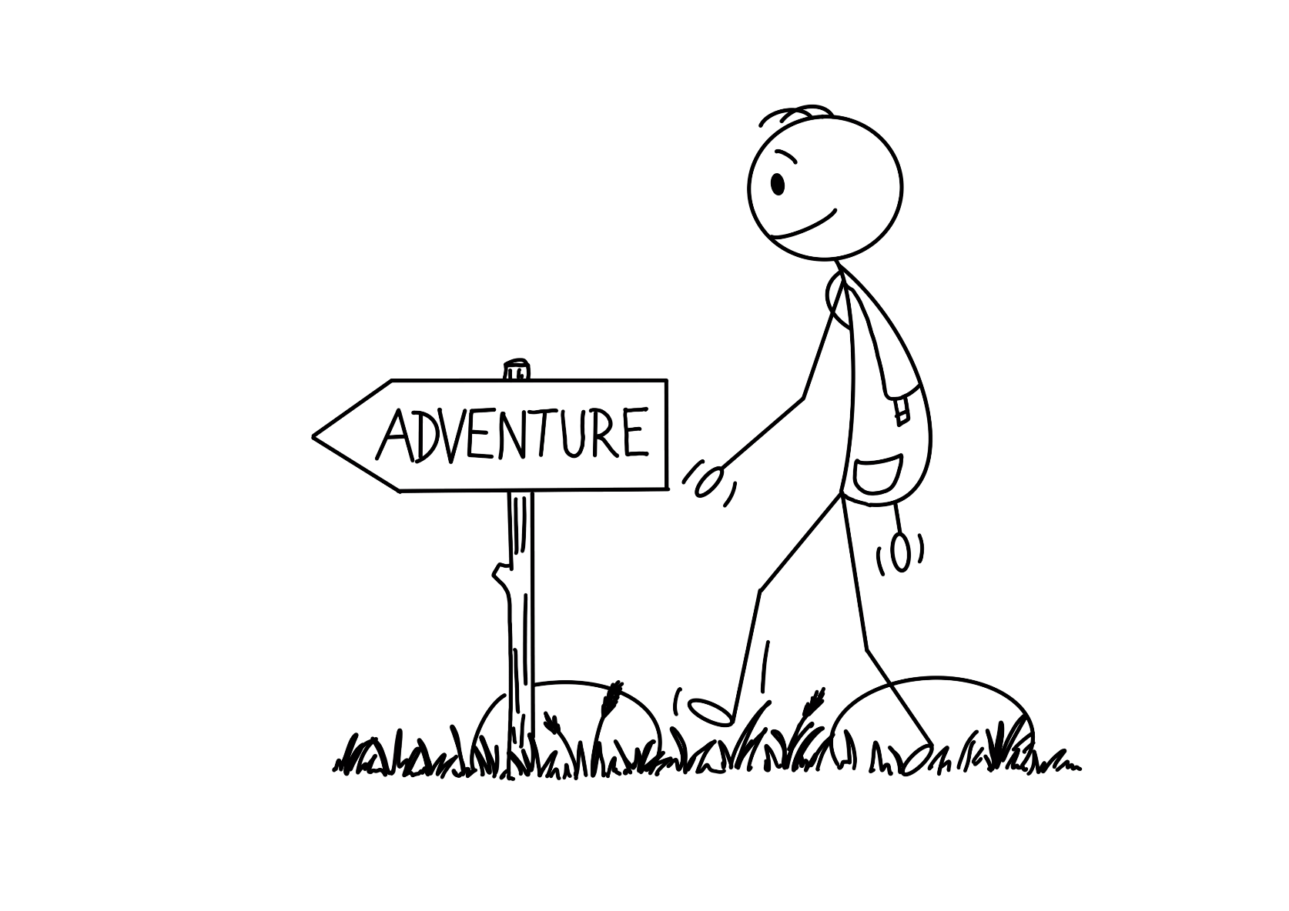
Every day is an adventure.
Notes:
Difficult things or challenges happen to us all.

Slide 2
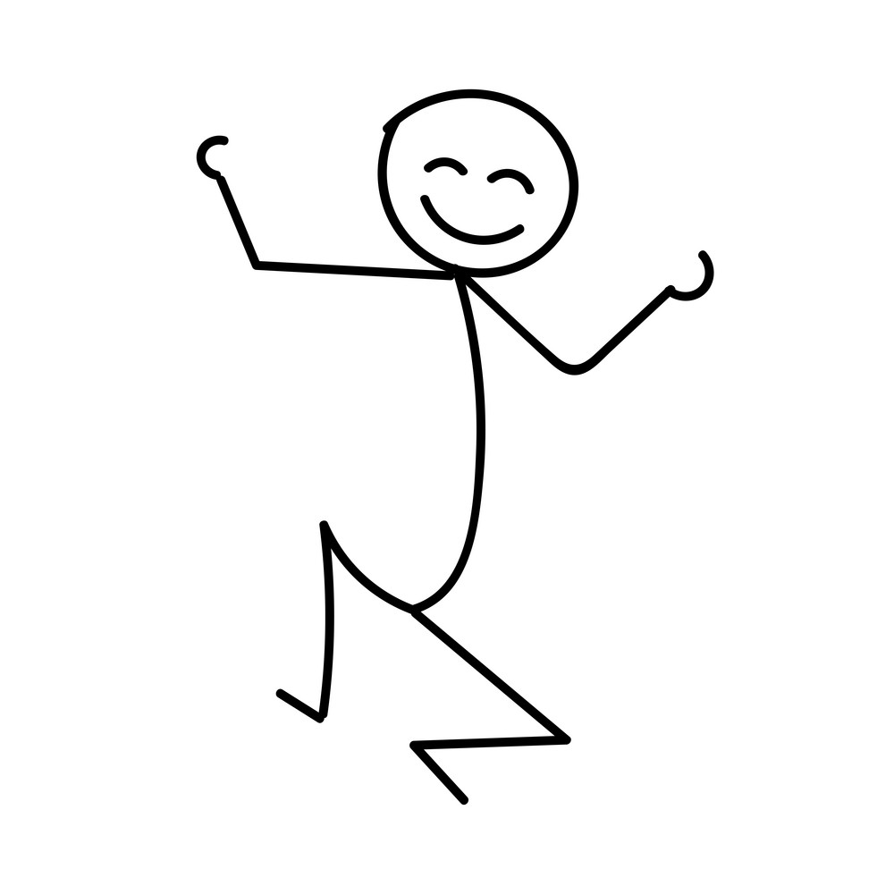
Sometime days are easy.

Slide 3
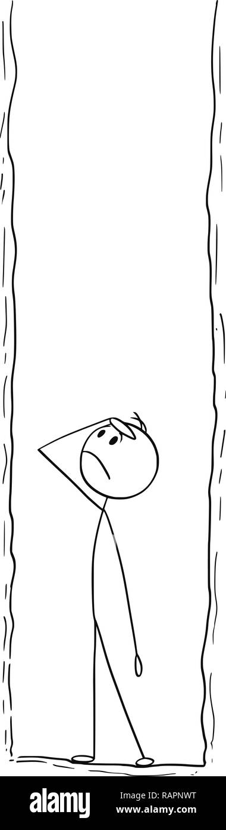
And some days are full of challenges.
Notes:
Difficult things or challenges happen to us all.

Slide 4
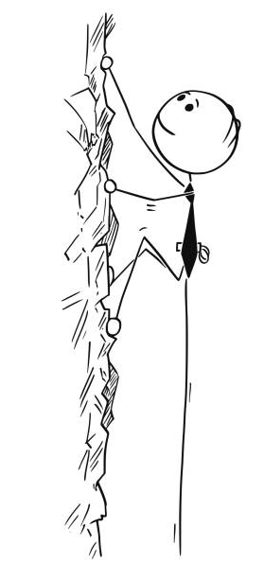
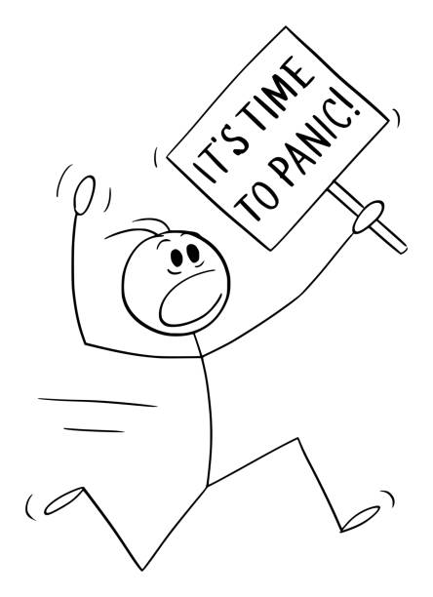
How we adapt to a situation that we didn’t expect or like or find a challenge is important.
Notes:
Difficult things or challenges happen to us all.

Slide 5
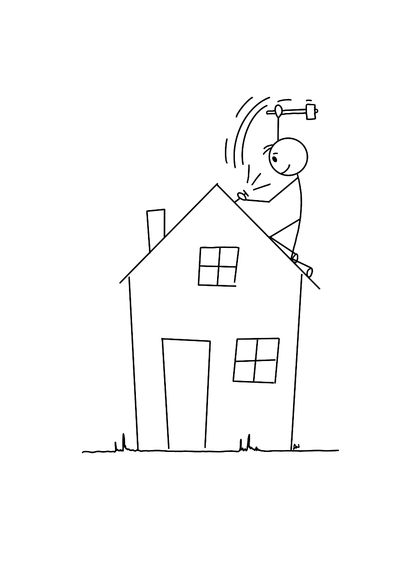
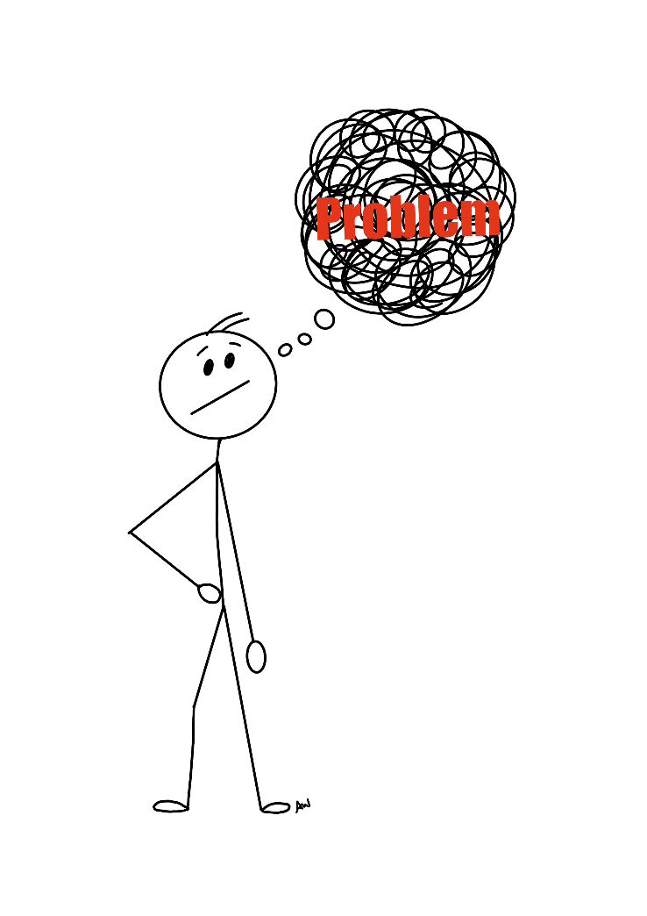
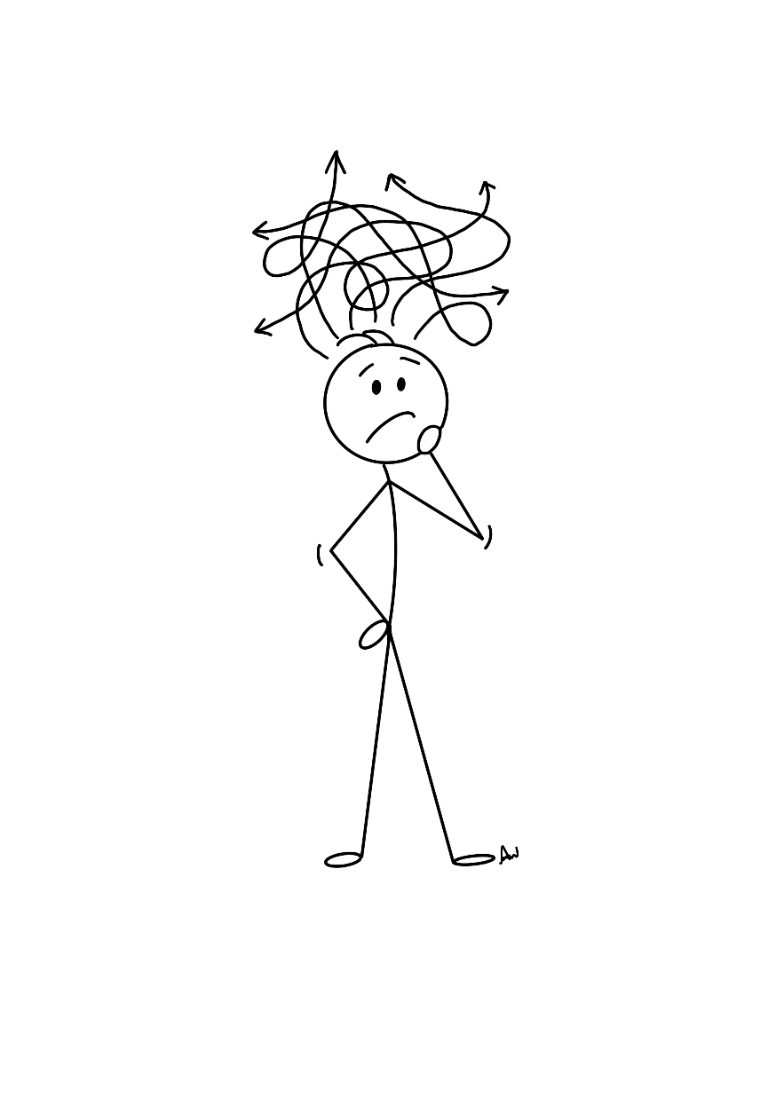
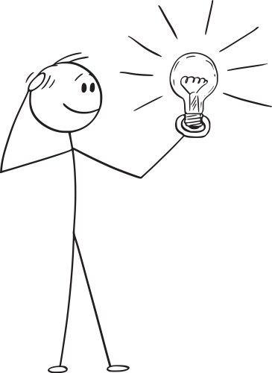
Learning ways to help us manage challenges can really make a difference.
Notes:
Difficult things or challenges happen to us all.

Slide 6
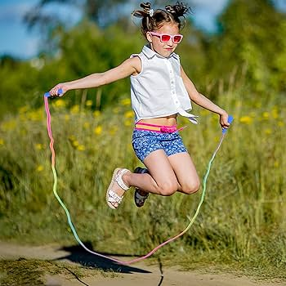
Notes:
One day years ago in the playground I can remember watching Eloise trying to skip with her friends. Now all of Eloise's friends were able to skip but she wasn’t. She kept tripping over the rope or getting the rope caught on her head. She just couldn’t get it. I could see it was really hard for her. She had a fierce look of concentration on her face and was nearly in tears. As the bell went she folded up her rope and went back into class with her friends. She was very quiet. At lunch time I had to go out to the playground again and I wondered if she would be there or if she would give up and do something else. But when I got outside I saw her with the rope once more trying to get it all right. As I watcher one of her friends stopped skipping and went over to her. She called out ‘You can do this Eloise I know you can’ and do you know what all of a sudden her arms and feet all worked together and she skipped 4 times before the rope go caught up. She looked at her friend and gave her the biggest smile. She had got it.

Slide 7

Share a time you faced a challenge….
What did you do?
What helped you keep going?
Who helped you keep going?

Slide 8
Resilience
Notes:
Has anyone ever heard of this word. Or knows what it means?
It is quite a tricky word to explain but it is a really important collection of skills that can really help us when we face challenges.
Resilience – the ability to manage or recover quickly from challenges or difficulties.

Slide 9

The most Magnificent thing.

Slide 10
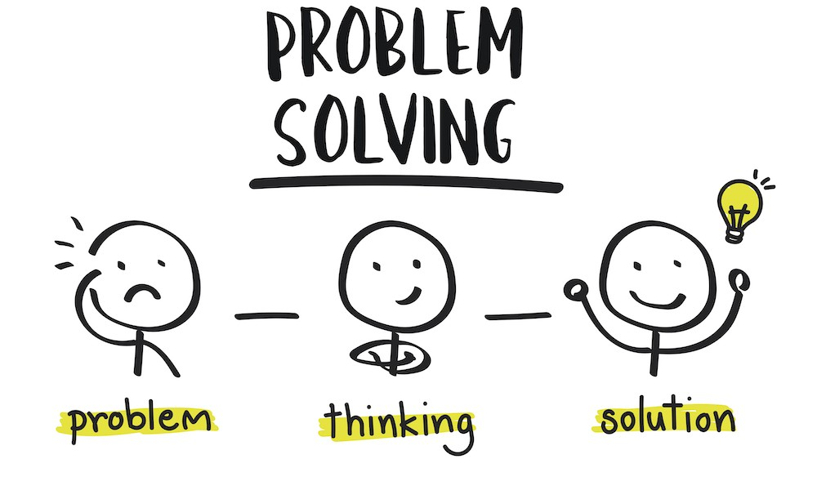
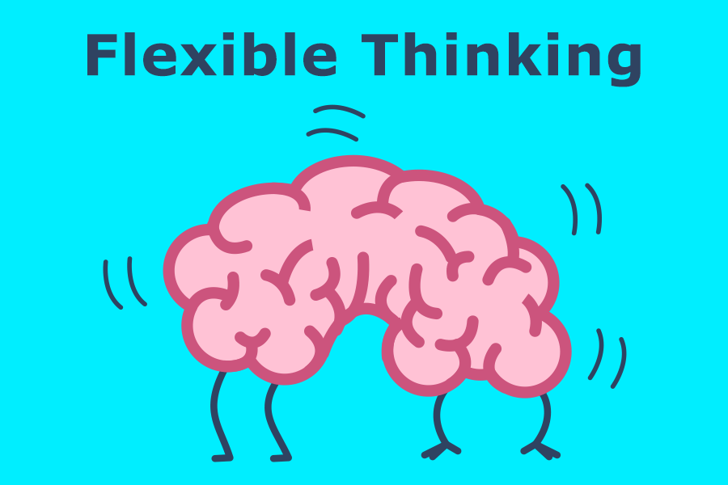

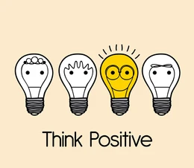
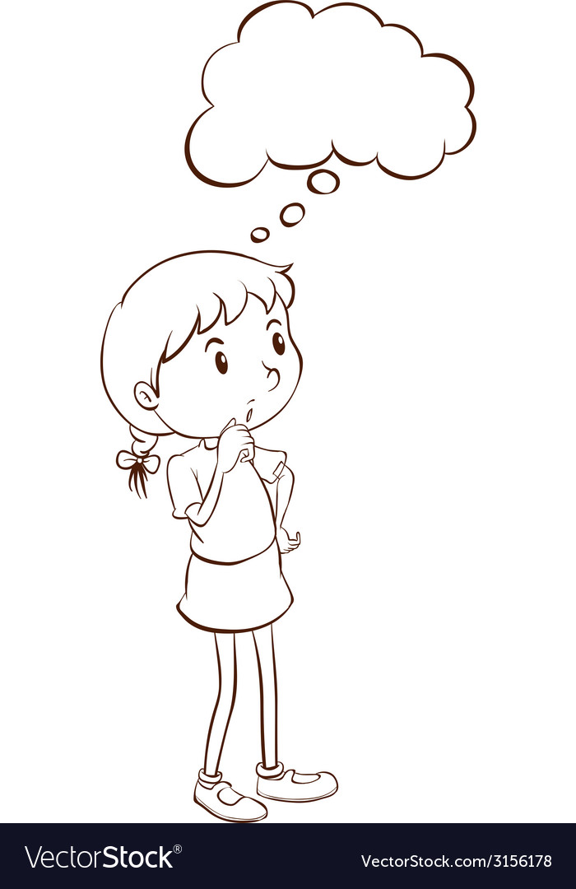
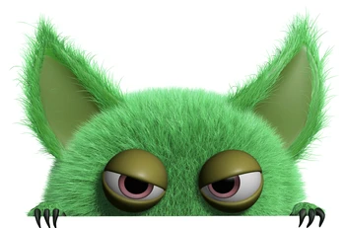
Manage Emotions
Notice the Gremlins in your thinking
Take a break & think
Notes:
Skills that can help us grow our resilience.
The Gremlins are the negative thoughts that interfere with what we want to do they hide and pop out when we are least expecting them to and make us doubt ourselves or our ideas.

Slide 11
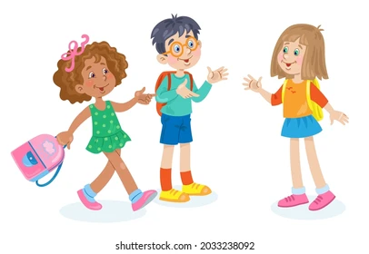
Talking to family and friends can help us work out what to do, keep us calm and problem solve.

Slide 12

Which skills did the little girl in the story use to help her ‘bounce back’ or be resilient?
Notes:
Share with the children how a ball bounces back when you drop it, whereas a large blob of plastercine rust stays stuck when you drop it.
She felt frustrated but kept going.
She made mistakes but thought about the problem and tried again.
She had an idea but used flexible thinking to change it when it didn’t work
She listened to her friend the dog and talked to him
She went for a walk and thought again about what she was doing.
Despite the Gremlins making her doubt herself working with the dog she was able to keep going.

Slide 13
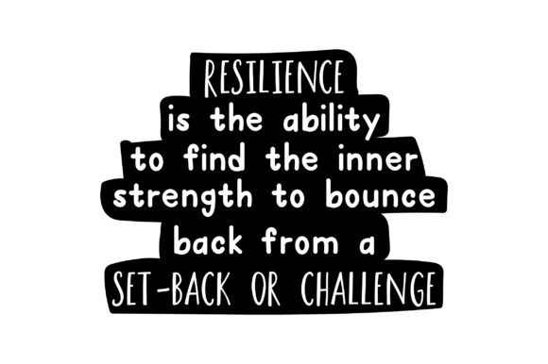

Notes:
Remember the little girl in my story at the beginning and how her friend helped her learn to skip. Her friend encouraged her and held the belief that she would be able to learn.
Give each of the children a picture of the ball as they leave assembly. Ask them to put on the back:
something they find hard and want to be able to master.
One way that people in their class would be able to help them
One thing they could say to themselves when they get fed up and want to give up.

Slide 14
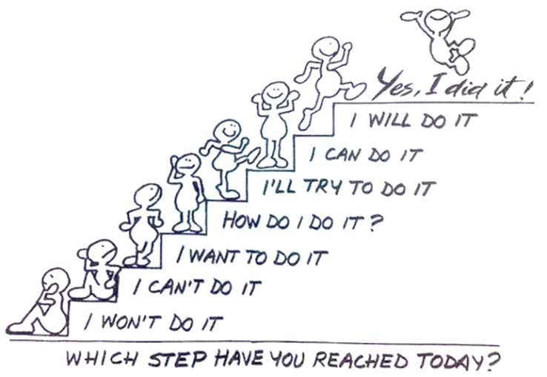
Notes:
Music to play as children leave. With a little help from my friends by the Beatles.

